Slide 1

Flow Control and Measurement
Creativity without a trip
Variations on a drip
Giving head loss the slip
Chemical doses that don’t dip
Here’s a tip!
We can use smart fluids to eliminate software, computers, and electronics!

Slide 2
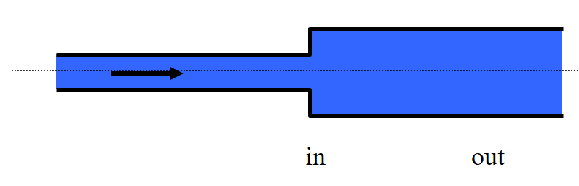
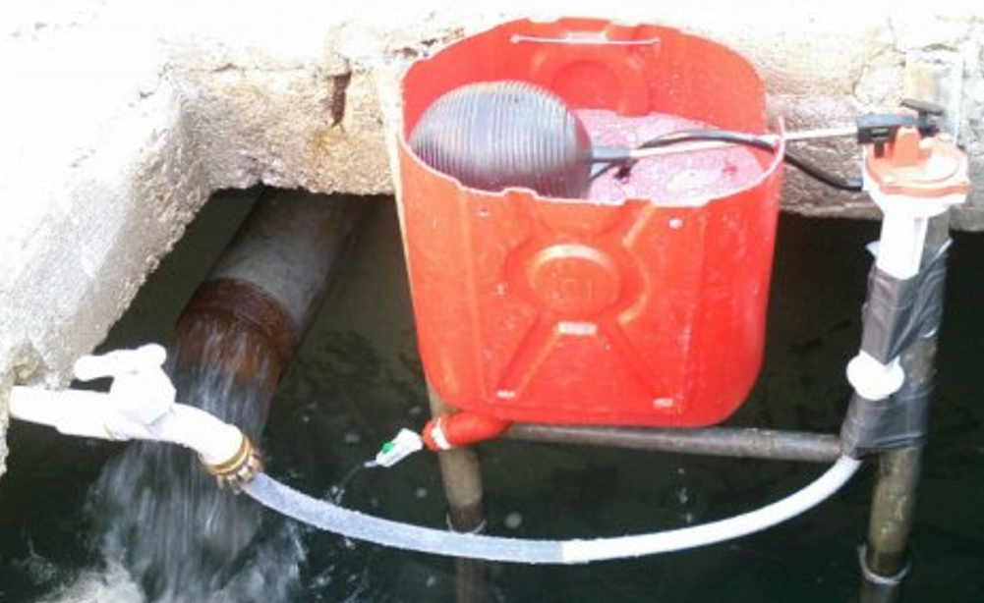
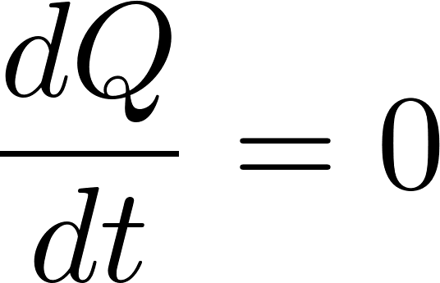


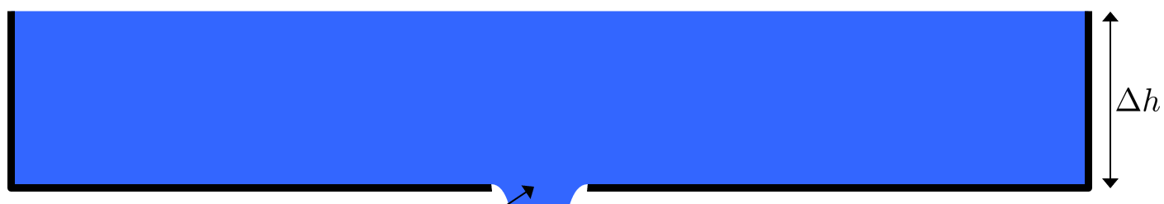
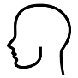
Overview
Fluids Review
Applications of flow control
If you had electricity
Hole in a bucket
Constant head devices
Floating bowl
Overflow tanks
Marriot bottle
Float valve
Hypochlorinators in Honduras
AguaClara Flow Controller
Linear Flow Orifice Meter
AguaClara Linear Dose Controller
Ctrl + click the pictures to go each section!

Slide 3
Overview
Fluids Review
Applications of flow control
If you had electricity
Hole in a bucket
Constant head devices
Floating bowl
Overflow tanks
Marriot bottle
Float valve
Hypochlorinators in Honduras
AguaClara Flow Controller
Linear Flow Orifice Meter
AguaClara Linear Dose Controller
Ctrl + click the pictures to go each section!

Slide 4
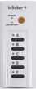
Fluids Review
What causes drag?
Best orientation to reduce drag?

Slide 5
Streamlines
Draw the streamlines that begin on the upstream side of the object for these two cases
Which object has the larger wake?
Which object has the lower pressure in the wake? (if streamlines are bending hard at the point of separation, then the streamlines will be close together…)

Slide 6
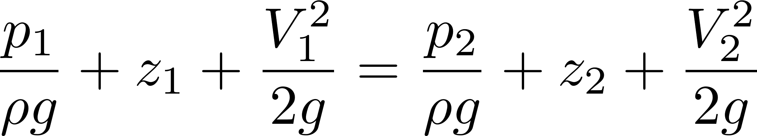
Why is there drag?
Fluid separates from solid body and forms a recirculation zone
Pressure in the recirculation zone must be low because velocity in the adjacent flowing fluid at the point of separation is high
Pressure in recirculation zone (the wake) is relatively constant because velocities in recirculation zone are low
Pressure behind object is low - DRAG

Slide 7
Fluids Review
Where should the luggage go?
Which equation for head loss?
Which process is inefficient?
Pipeline design

Slide 8
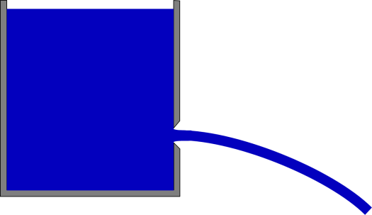
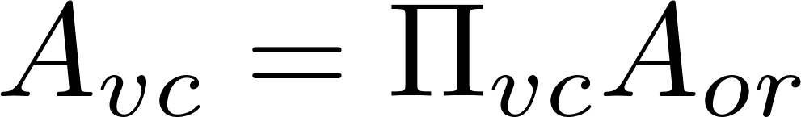
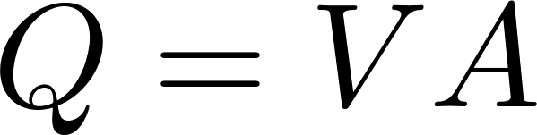

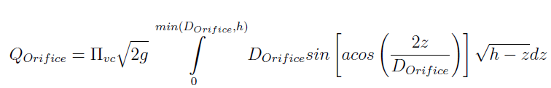
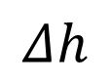
Orifice Equation
z₁
$$Δh$$
z₂ = 0
Flow contraction!
mechanical
Bernoulli equation (no energy loss)
^
Area of the constricted flow
Continuity equation
Orifice Equation (memorize this!)

Slide 9
Orifice Equation
z₁
$$Δh$$
z₂ = 0
Flow contraction!
This equation applies to a horizontal orifice (so that the depth of submergence is constant). For depth of submergence larger than the diameter of the orifice this equation can be applied to vertical orifices. There is a general equation for vertical orifices in physchem.py within aide_design.

Slide 10
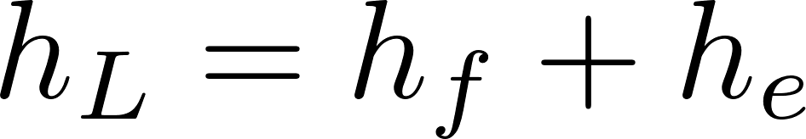
Two kinds of drag Two kinds of head loss
Drag (external flows)
Head loss (internal flows)
Skin (or shear) friction
Shear on solid surface
Classic example is flat plate
Form (or pressure) drag
Separation of streamlines from solid surface and wake results in a…
Flow expansion (behind object)
Major losses (h_{f} – friction)
Shear on solid surface
Shear on pipe walls
Minor losses (h_{e} – expansion)
Separation of streamlines from solid surface results in a…
Flow expansion
Energy equation (NOT THE BERNOULLI EQUATION)

Slide 11
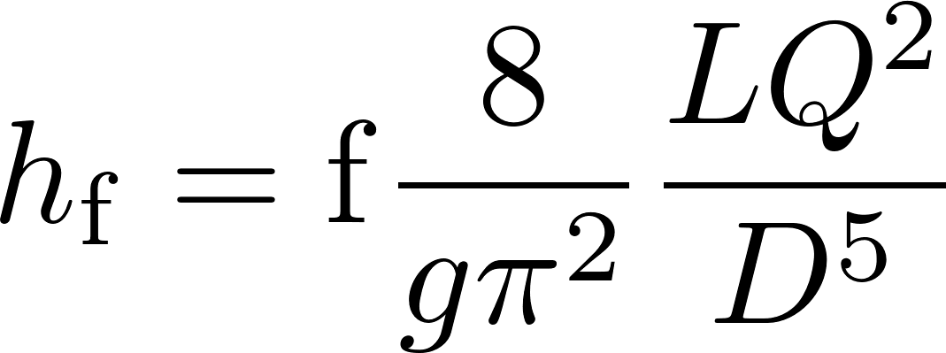
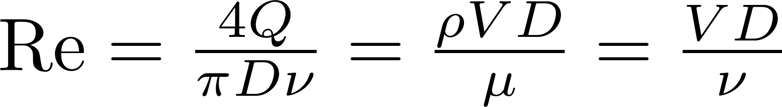
Head Loss in a Long STRAIGHT Tube (due to wall shear): Major Losses
Darcy Weisbach:
This equation gives the major losses for BOTH laminar and turbulent flow.
How to find the friction factor for wall shear, f?
First, find Reynold’s number
Transition from turbulent to laminar occurs at Re~2100

Slide 12
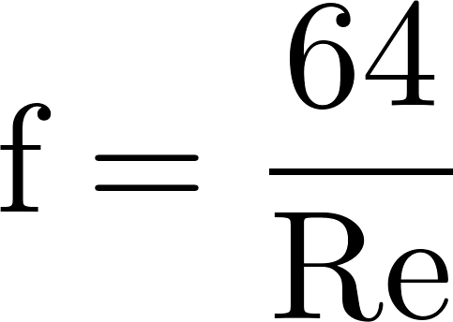
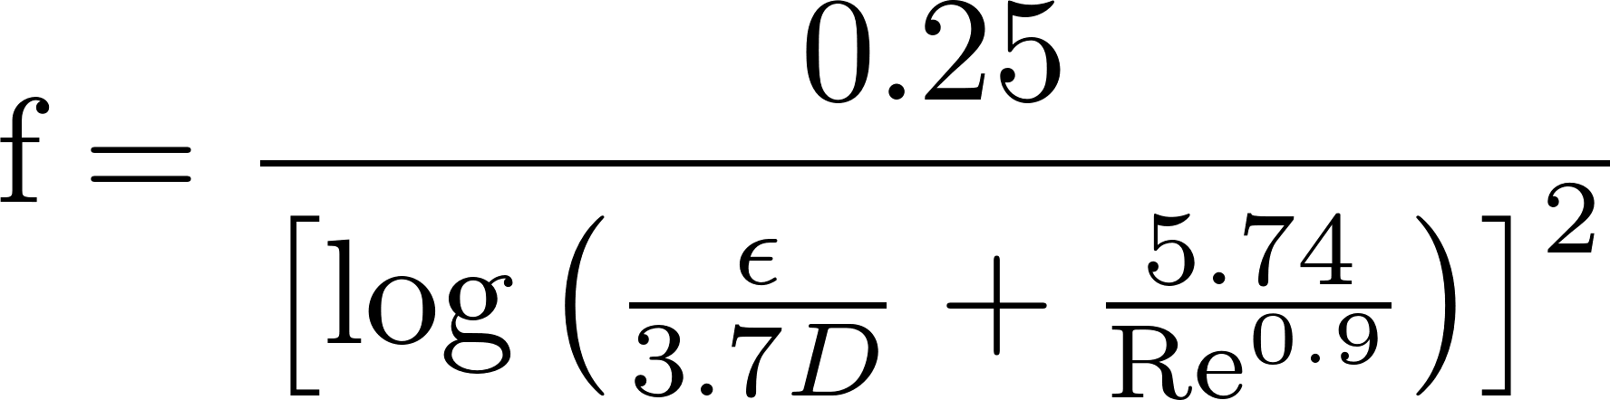

Head Loss in a Long STRAIGHT Tube (due to wall shear): Major Losses
Laminar
if Re < 2100,
Major loss equation simplification (for laminar flow only!):
Turbulent
if Re > 2100,
Swamee-Jain
Where Ɛ is the wall roughness
(no h_{f} equation simplification😢)
Hagen-Poiseuille
h_{f} proportional flow

Slide 13
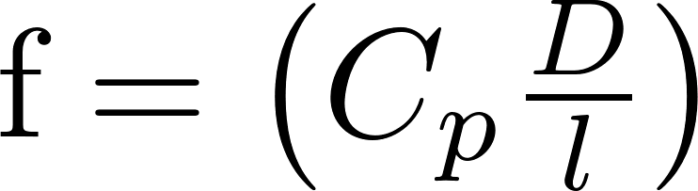
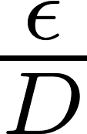
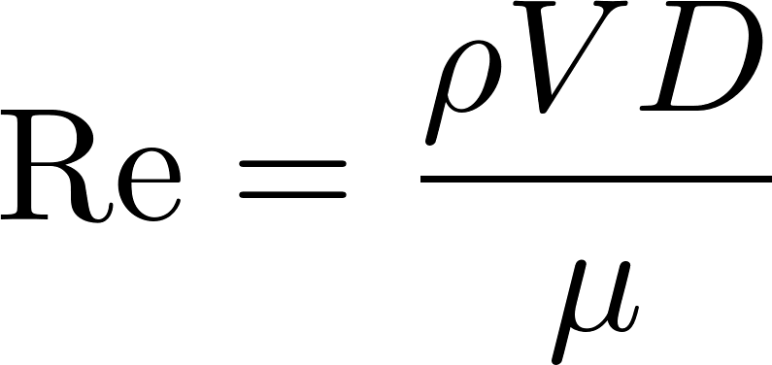
Frictional Losses in Straight Pipes
0.1
0.05
0.04
0.03
0.02
0.015
0.01
0.008
friction factor
0.006
0.004
laminar
0.002
0.001
0.0008
0.0004
0.0002
0.0001
0.01
0.00005
smooth
1E+03
1E+04
1E+05
1E+06
1E+07
1E+08
Re

Slide 14

Head Loss: Minor Losses
Head (or energy) loss (h_{L}) due to: outlets, inlets, bends, elbows, valves, pipe size changes
Losses are due to expansions
Losses can be minimized by gradual expansions
Minor Losses have the form where K_{e} is the loss coefficient and V is some characteristic velocity (could be contracted flow or expanded flow)
When V, KE  thermal

Slide 15
Head Loss due to Sudden Expansion: Conservation of Energy
z
x
in
out
At centroid of control surface
Where is p measured?___________________________
z_{in} = z_{out}
Notes:
Suppose mechanical energy is conserved (it isn’t!) in this flow. What would have to be true of the downstream pressure? (It would have to be higher than the upstream pressure.)
Does water like to move from a region of low pressure into a region of high pressure?
Flow into region of higher pressure causes any curved streamlines to curve even more! Given that the flow is slowing down the streamlines MUST BE diverging. The increasing pressure causes the streamlines to bend even more. We get turbulence!

Slide 16
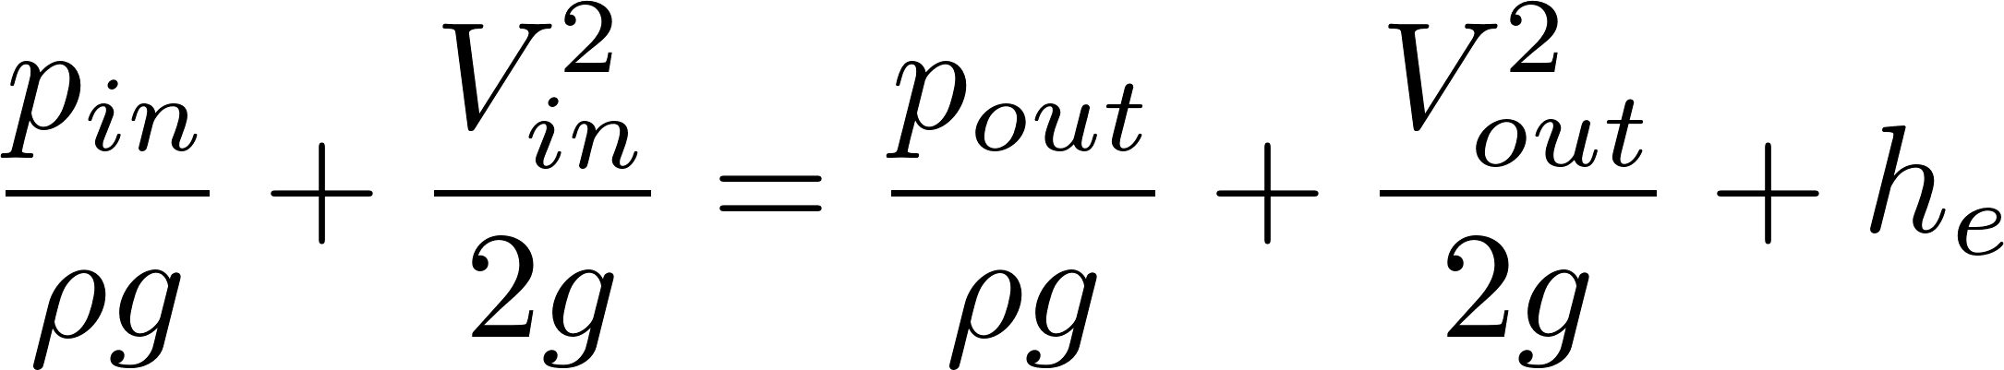
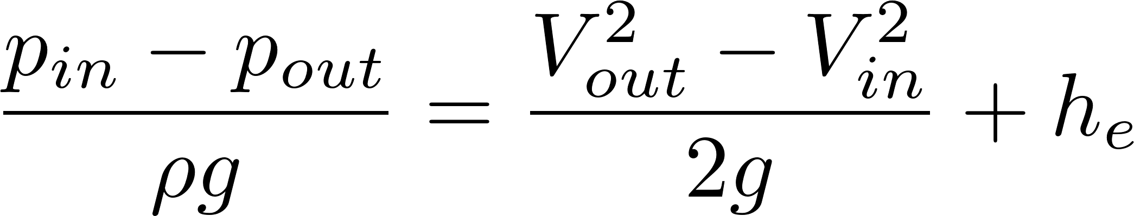
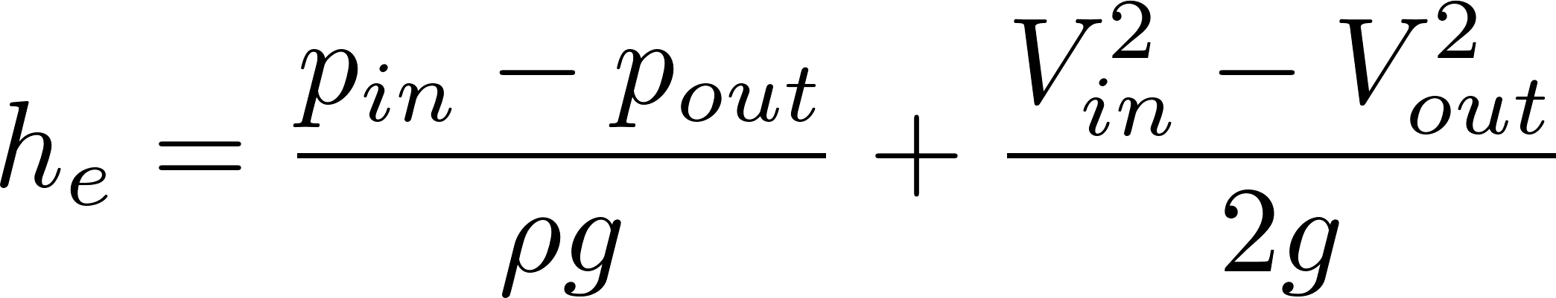
Head Loss due to Sudden Expansion: Conservation of Energy
z
x
in
out
These 3 are the same equation, simply rearranged
Relate V_{in} and V_{out}?
Mass
Relate p_{in} and p_{out}?
Momentum
Notes:
Suppose mechanical energy is conserved (it isn’t!) in this flow. What would have to be true of the downstream pressure? (It would have to be higher than the upstream pressure.)
Does water like to move from a region of low pressure into a region of high pressure?
Flow into region of higher pressure causes any curved streamlines to curve even more! Given that the flow is slowing down the streamlines MUST BE diverging. The increasing pressure causes the streamlines to bend even more. We get turbulence!

Slide 17
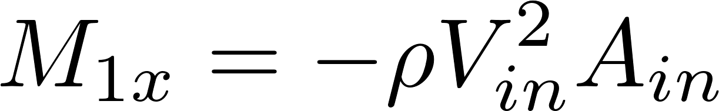
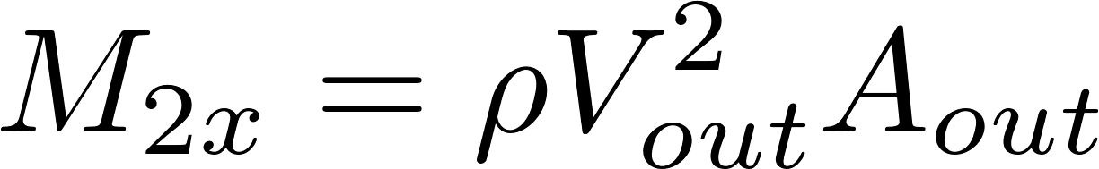
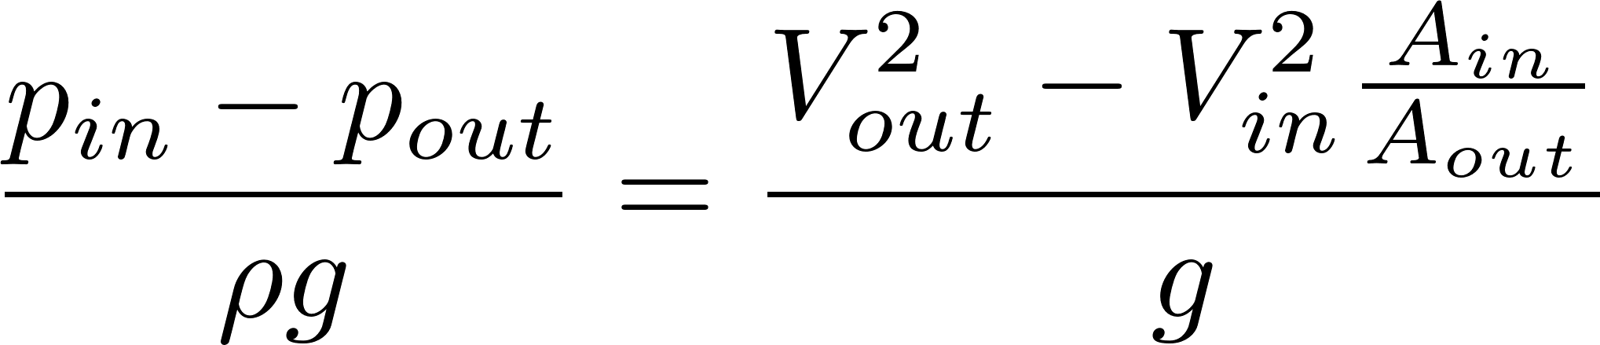
Head Loss due to Sudden Expansion: Conservation of Momentum
A_{out}
A_{in}
x
1
2
Apply in direction of flow
Neglect surface shear
Pressure is applied over all of section 1.
Momentum is transferred over area corresponding to upstream pipe diameter.
V_{in} is velocity upstream.

Slide 18
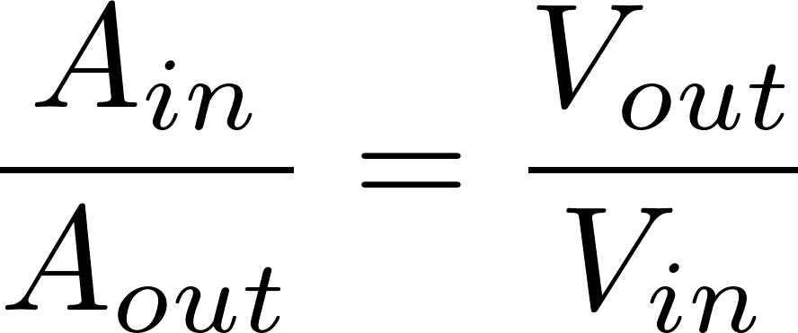
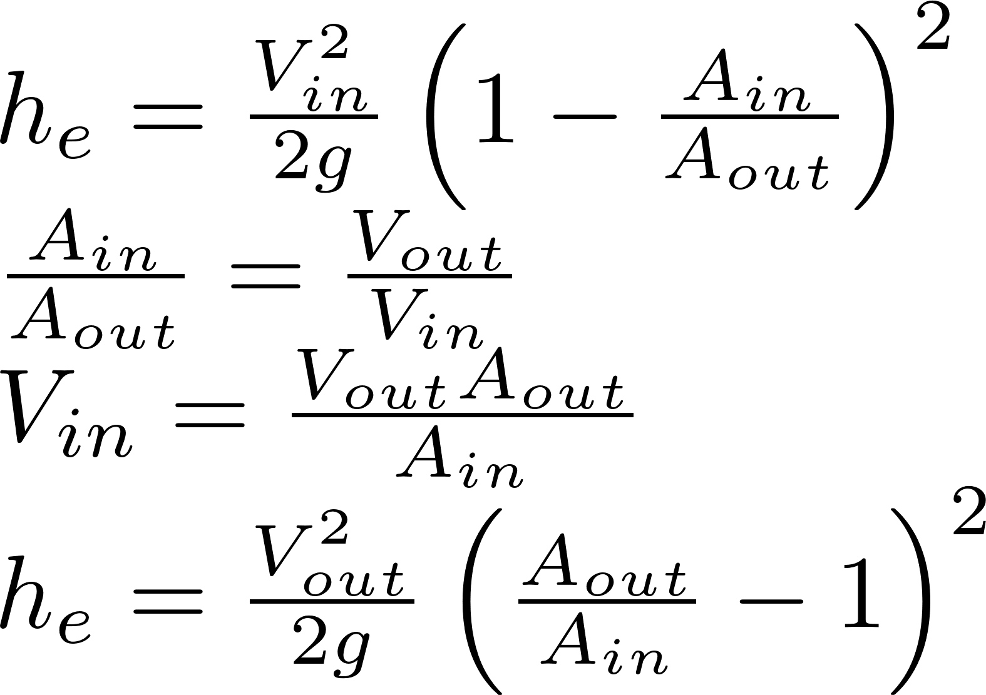
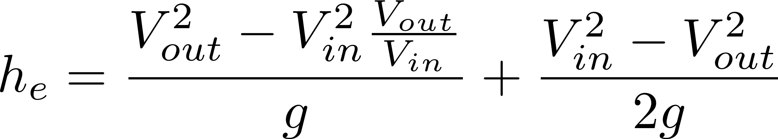
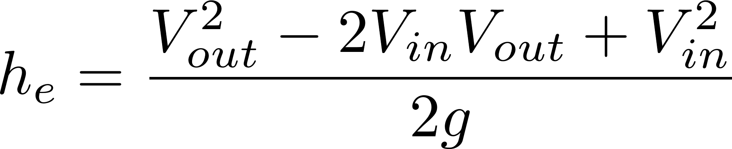
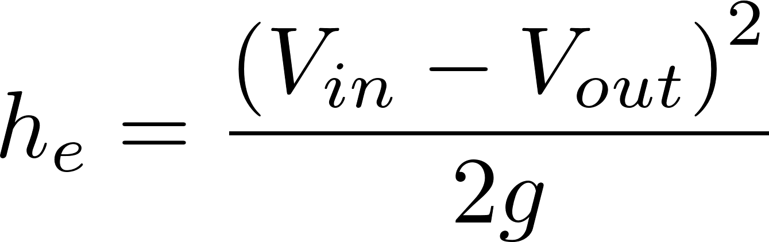
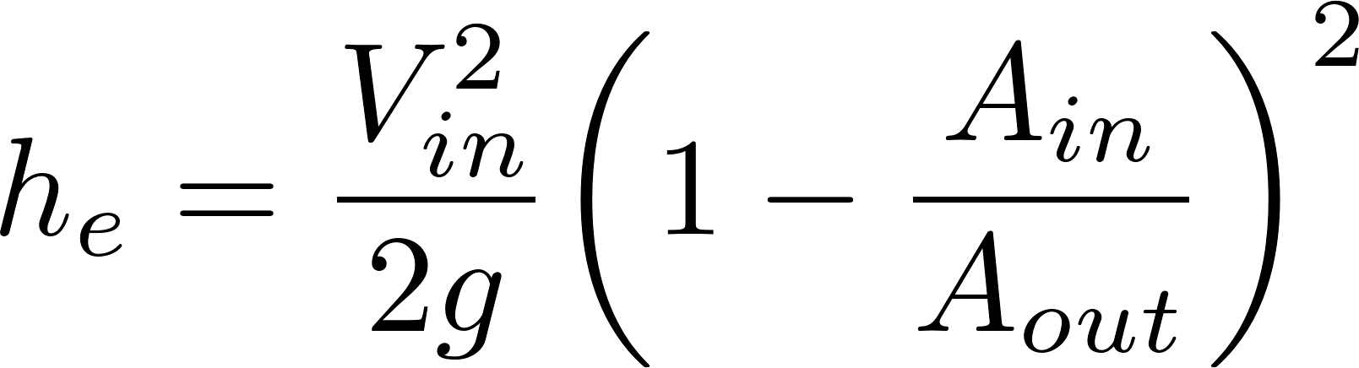
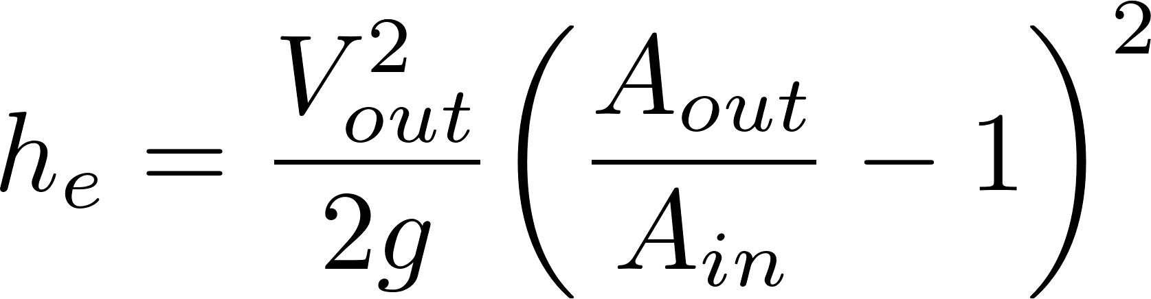
Head Loss due to Sudden Expansion
Energy
Mass
Momentum
2
2
2
K_{e}
K_{e}’
Discharge into a reservoir?__________________
Loss coefficient = 1
Notes:
Emphasize the minor loss coefficient is defined based on some relevant velocity. We can chose either V1 or V2. But the magnitude of the minor loss coefficient is determined by which velocity we use. We need to choose one and be consistent. The velocity that we choose will be a function of convenience. Minor losses are proportional to the square of the velocity. This is true whether the flow is turbulent or laminar!

Slide 19
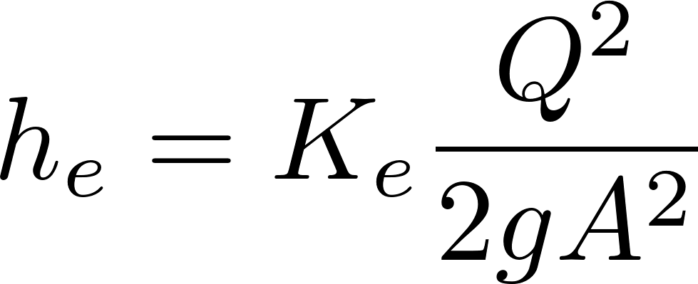
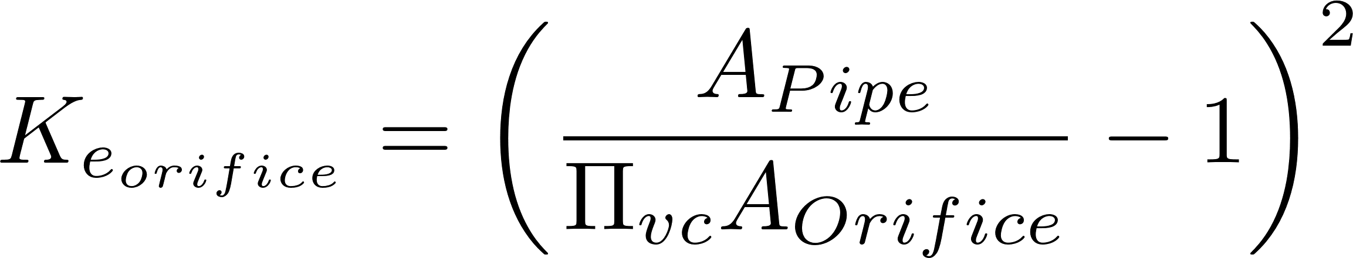

Minor Loss Coefficient for an Orifice in a Pipe (D_{Orifice} < < D_{pipe})
extra
e for expansion
Minor loss coefficient
Expansion losses
This is V_{out}, not V_{in}
h_{L}
Vena contracta area
D_{Orifice}
D_{Pipe}
Notes:
Draw the orifice case in detail showing expansion zone

Slide 20

Minor Loss Coefficient for an Orifice in a pipe
extra
The expansion starts from the vena contracta
Notes:
Draw the orifice case in detail showing expansion zone

Slide 21
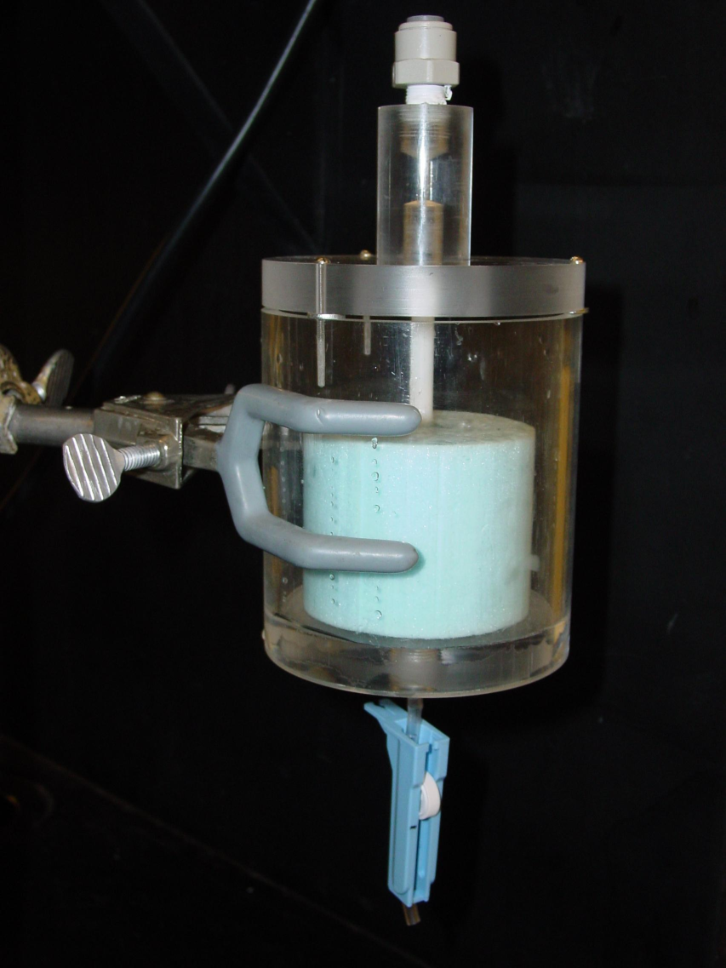
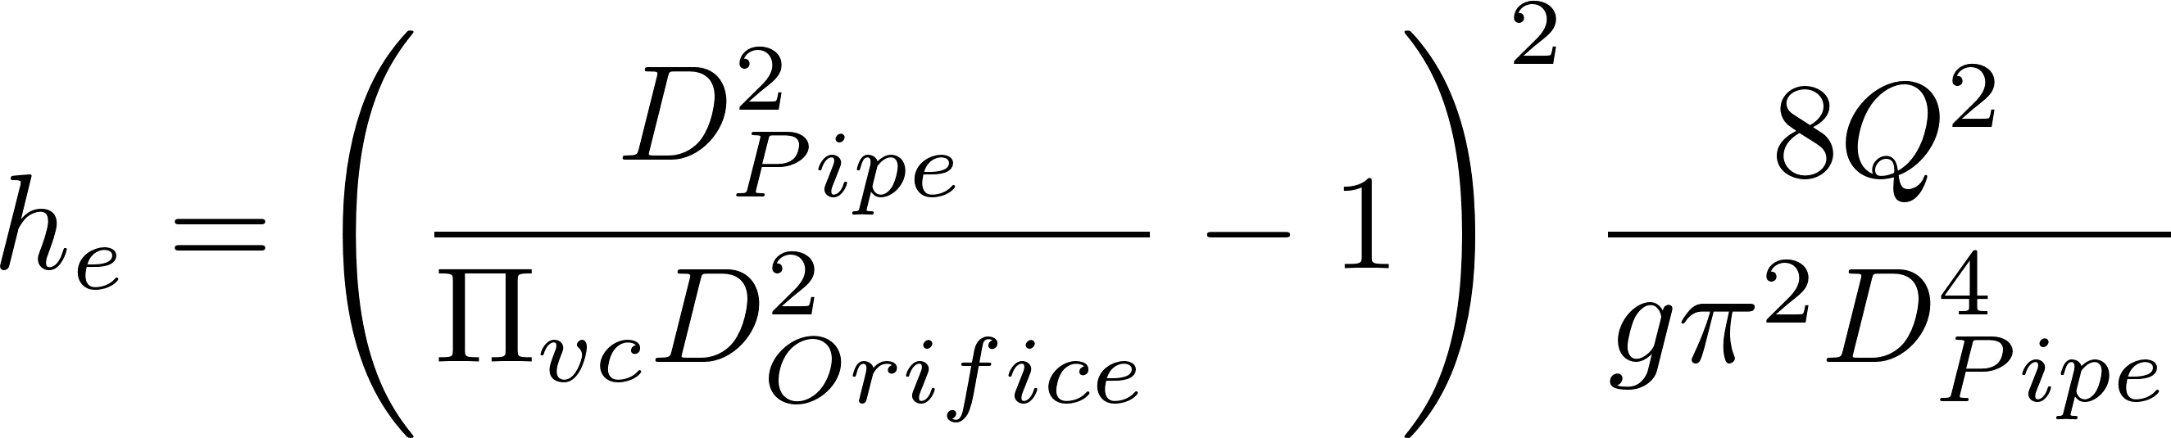
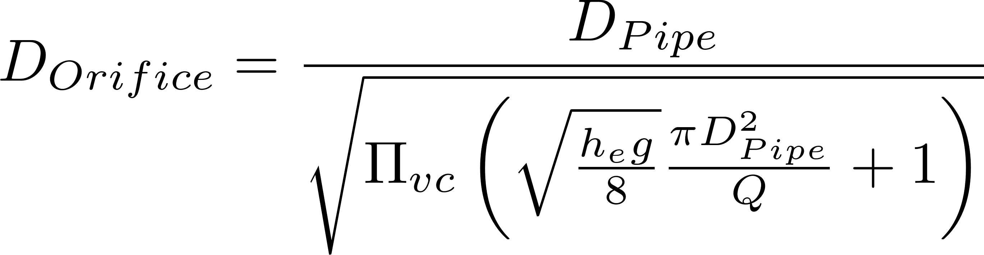
Equation for the diameter of an orifice in a pipe given a head loss
extra
Minor losses dominate, thus h_{e} = h_{L}
Where do changes in pressure occur?
Where does head loss occur?

Slide 22
Overview
Fluids Review
Applications of flow control
If you had electricity
Hole in a bucket
Constant head devices
Floating bowl
Overflow tanks
Marriot bottle
Float valve
Hypochlorinators in Honduras
AguaClara Flow Controller
Linear Flow Orifice Meter
AguaClara Linear Dose Controller
Ctrl + click the pictures to go each section!

Slide 23
Applications of Constant Flow
POU treatment devices (Point of Use)
clay pot filters
SSF (slow sand filters)
Arsenic and fluoride removal devices
Reagent addition for community treatment processes
Alum or Poly Aluminum Chloride (PACl) ____________
Calcium or sodium hypochlorite for ____________
Sodium carbonate for _____________
A flow control device that maintains a constant dose as the main flow varies
coagulation
disinfection
pH control

Slide 24
Overview
Fluids Review
Applications of flow control
If you had electricity
Hole in a bucket
Constant head devices
Floating bowl
Overflow tanks
Marriot bottle
Float valve
Hypochlorinators in Honduras
AguaClara Flow Controller
Linear Flow Orifice Meter
AguaClara Linear Dose Controller
Ctrl + click the pictures to go each section!

Slide 25




If you had electricity…
Metering pumps (positive displacement)
Pistons
Gears
Peristaltic
Diaphragm
Valves with feedback from flow sensors
So an alternative would be to raise the per capita income and provide RELIABLE electrical service to everyone…
But a simpler solution with fewer moving parts would be better!

Slide 26
A couple of observations…
Municipal water treatment often fails due to unreliable chemical dosing of chlorine and coagulants
Failure modes include
Inability to easily set the target dose
Lack of easy method for operators to monitor flow
Poor designs that don’t maintain a constant dose

Slide 27


Slide 28

Dosing at a large city Water Treatment Plant in Nepal
One 25 kg block of alum at a time
Placed in the channel carrying raw water into the plant

Slide 29
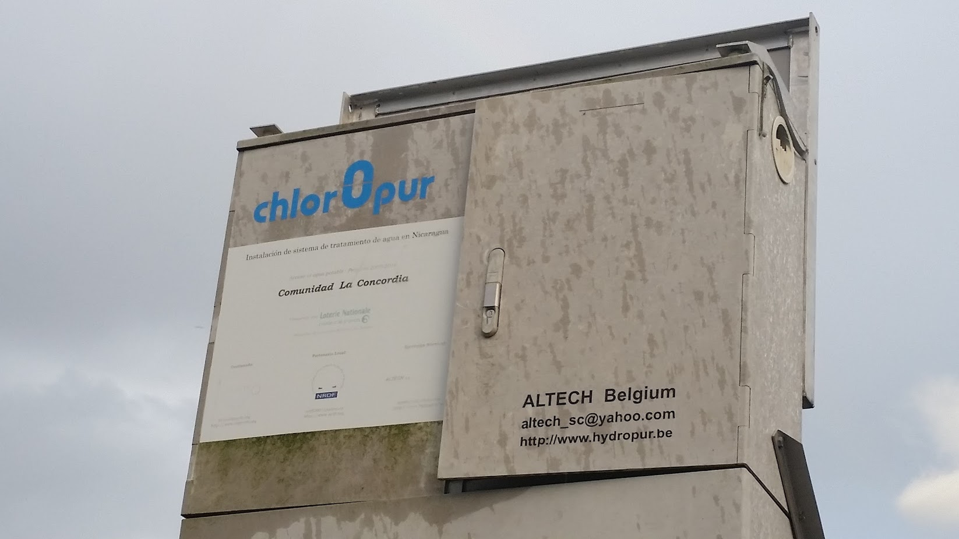
Salt water electrolytic chorine generators

Slide 30

Chlorine tablet chlorinators

Slide 31
Overview
Fluids Review
Applications of flow control
If you had electricity
Hole in a bucket
Constant head devices
Floating bowl
Overflow tanks
Marriot bottle
Float valve
Hypochlorinators in Honduras
AguaClara Flow Controller
Linear Flow Orifice Meter
AguaClara Linear Dose Controller
Ctrl + click the pictures to go each section!

Slide 32


The Challenge of Chemical Metering (Hypochlorinator)
What is the simplest representation that captures the fluid mechanics of this system?
Access door to hypochlorinator tank
Overflow tube
Chlorine solution
Access door to distribution tank
PVC valve
PVC pipe
Chlorine drip
Raw water entering distribution tank

Slide 33



Hole in a bucket doesn’t give a constant flow rate
Orifice
Vena contracta
Q is flow rate [volume/time]
This is NOT a minor loss coefficient
It is the ratio of the vena contracta area to the orifice area

Slide 34
Use Conservation of Mass and Minor Loss equation [Two unknowns (Q, h)]
Our goal: To determine the height (h) of chlorine in the tank and its flow rate out of the tank (Q) as a function of time (t)
h₀

Slide 35
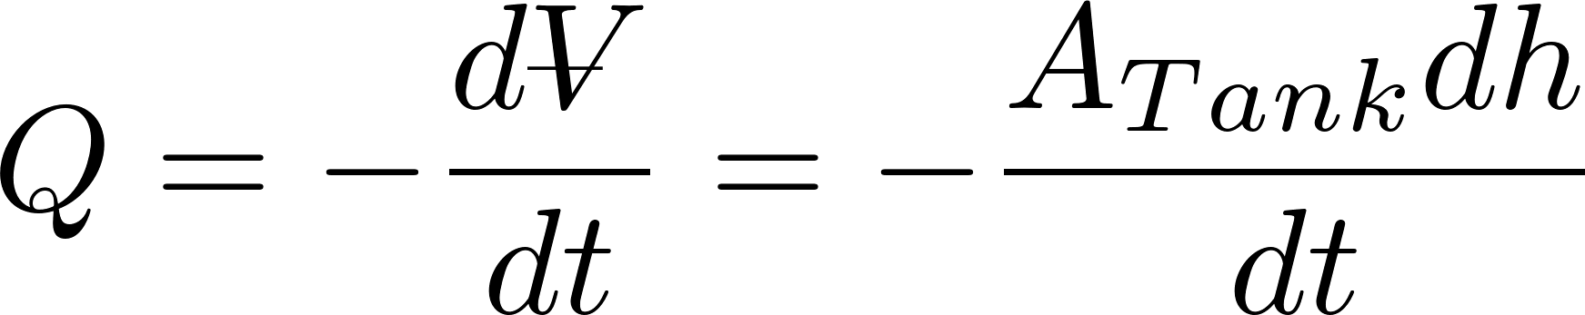
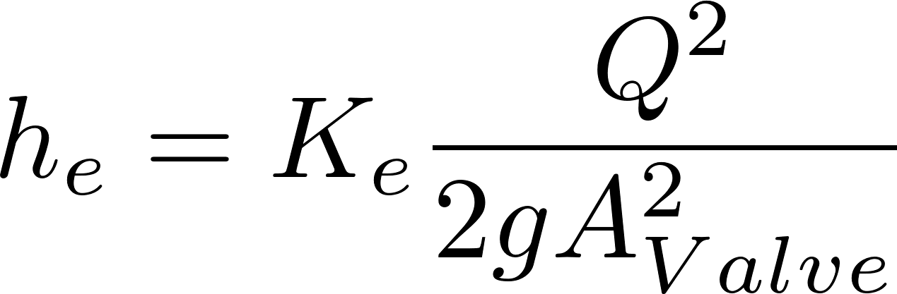
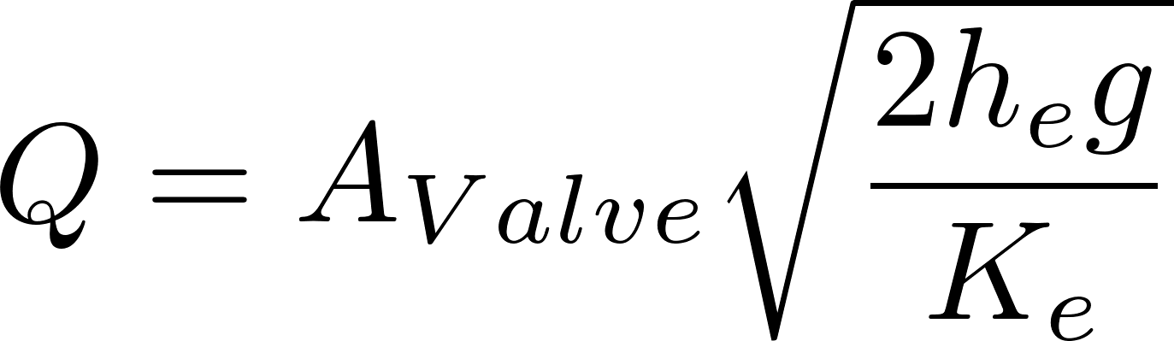
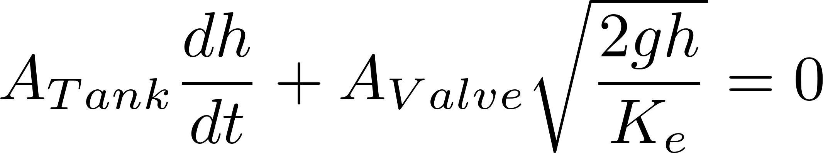
Use Conservation of Mass and Minor Loss equation [Two unknowns (Q, h)]
Mass conservation on liquid in tank
volume
Plan view area
h₀
Minor loss equation
Orifice in the PVC valve
Integrate to get h as f(t)

Slide 36
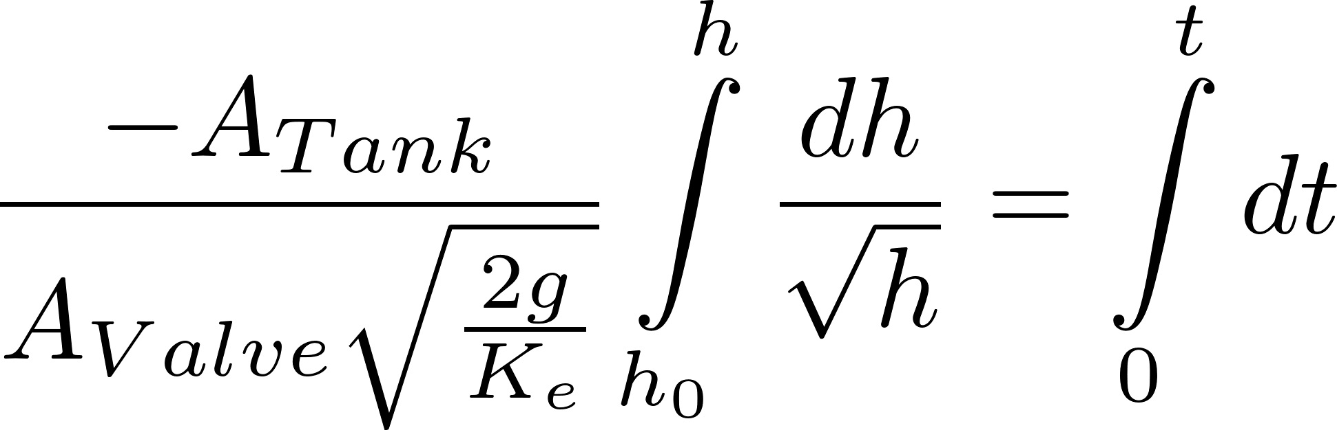
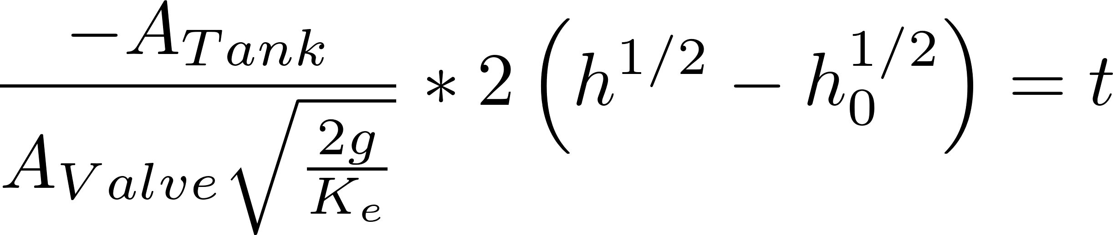
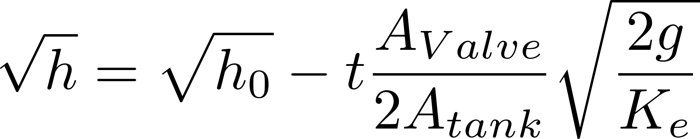
Finding the chlorine depth as f(t)
Separate variables
Integrate
Solve for height

Slide 37
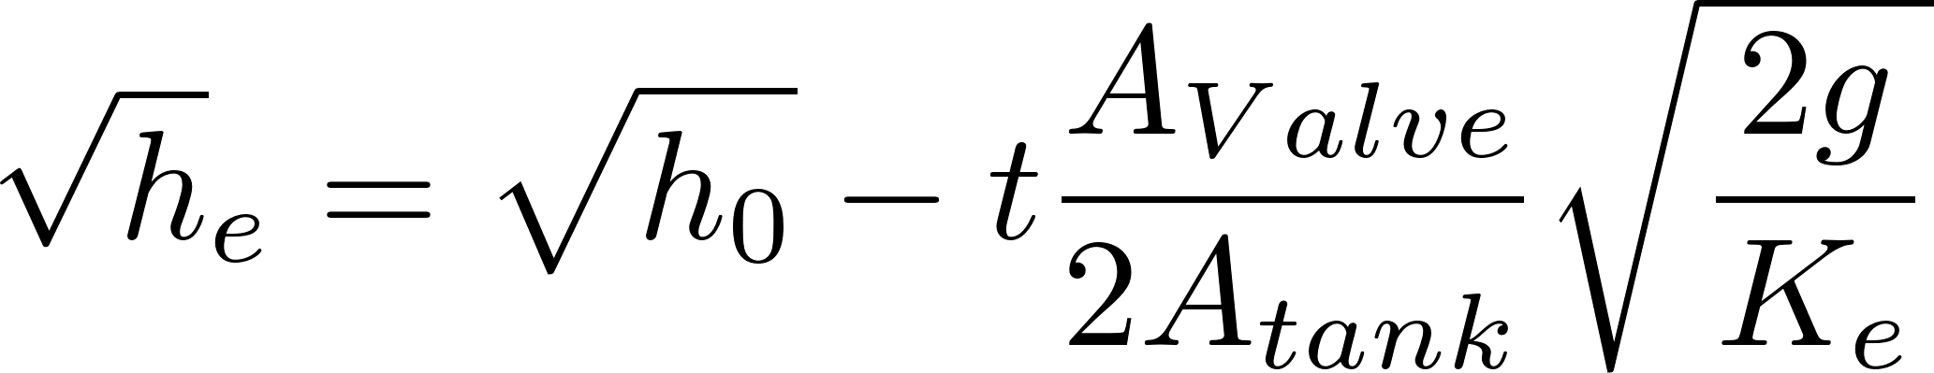
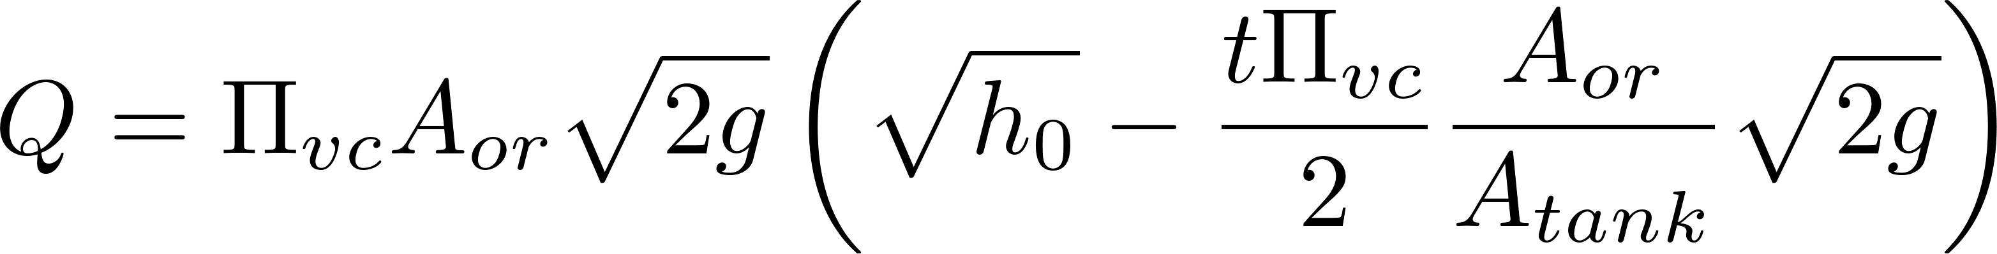
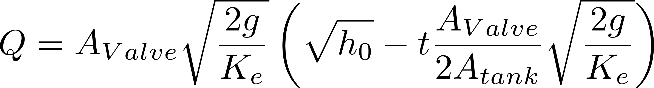
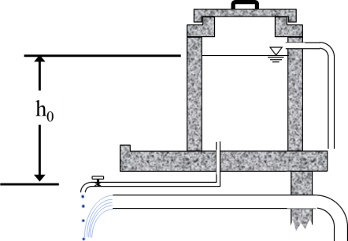

Finding Q as f(t)
Find A_{Valve} as function of initial target flow rate
Set the valve to get desired dose initially

Slide 38





Surprise… Q and chlorine dose decrease linearly with time!
Linear decrease in flow with time
Relationship between Q₀ and A_{Tank}?
Assume flow at Q₀ for time (t_{Design}) would empty reservoir
Notes:
When does the flow rate go to zero?
What is the average flow rate during this process if the tank is drained completely? 0.5 Q0.
How could you modify the design to keep Q more constant?

Slide 39



Reflections
Let the discharge to atmosphere be located at the elevation of the bottom of the tank…
When does the flow rate go to zero?
What is the average flow rate during this process if the tank is drained completely?
How could you modify the design to keep Q more constant?

Slide 40

Effect of tank height above valve
Case 1, h₀=50 m, h_{tank} = 1 m, t_{design}=4 days
h_{tank}
Case 2, h₀=1 m, h_{tank} = 1 m, t_{design}=4 days

Slide 41





A related tangent… Design a drain system for a tank
Integrated results giving h as f(t)
0
Empty the tank completely
Substitute valve diameter
Here K_{e} is the total minor loss for the drain system

Slide 42
Brainstorm: Constant Flow
Why did the previous systems not provide constant flow of chlorine?
Why is this hard?
What are the desired properties of the device that meters chemicals into a water treatment plant?
Notes:
What is the simple energy source?
Big question is can we develop a dosing system based on fluid dynamics.
Elegant simplicity
Few moving parts
Easy for the operator to set the chemical dose (rather than flow)

Slide 43
Overview
Fluids Review
Applications of flow control
If you had electricity
Hole in a bucket
Constant head devices
Floating bowl
Overflow tanks
Marriot bottle
Float valve
Hypochlorinators in Honduras
AguaClara Flow Controller
Linear Flow Orifice Meter
AguaClara Linear Dose Controller
Ctrl + click the pictures to go each section!

Slide 44
Constant Head: Floats
Head can be varied by changing buoyancy of float
orifice
Supercritical open channel flow!
VERY Flexible hose
Unaffected by downstream conditions!

Slide 45
Hypochlorinator with float design
What is the simplest representation that captures the fluid mechanics of this system?
Access door to hypochlorinator tank
Overflow tube
Float
Orifice
Chlorine solution
Access door to distribution tank
Transparent flexible tube
PVC valve
PVC pipe
Chlorine drip
Raw water entering distribution tank

Slide 46



Floating Bowl
Adjust the flow by changing the rocks
Need to make adjustments (INSIDE) the chemical tank
Rocks are submerged in the chemical
Safety issues

Slide 47

Constant Head: Overflow Tanks
Surface tension effects here
What controls the flow?

Slide 48
Constant Head: Marriot bottle
A simple constant head device
Why is pressure at the top of the filter independent of water level in the Marriot bottle?
What is the head loss for this filter?
Disadvantage? ___________
batch system

Slide 49

Constant Head: Float Valve
Float adjusts opening to maintain relatively constant water level in lower tank (independent of upper tank level)
NOT Flow Control!
h_{tank}
d_{orifice}
h_{submerged}
?
Force balance on float valve?
d_{float}

Slide 50
Our goal is to adjust the flowrate and then maintain constant flow
Head (or available energy to push fluid through the flow resistance) (voltage drop)
Flow resistance (resistor)
____________________________________
____________________________________
____________________________________
Vary either the head or the flow resistance to vary the flow rate (current)
Vary head by adjusting the constant head tank elevation or the outlet elevation of a flexible tube
Vary orifice size by adjusting a valve
Orifice i.e. small hole or restriction
Porous media
Long straight small diameter tube

Slide 51
Variable Orifice
Variable head or variable resistance?
How is flow varied?
Variable orifice area
How would you figure out the required size of the orifice?
Notes:
Dan Smith
Steve
Constant head, vary resistance!

Slide 52


Float valve and small tube variable head
straight
^
chemical stock tank
Flow control device
If laminar flow!
Small diameter tubing
h_{L}
Neglecting minor losses
Notes:
Peter von Bucher
Presidential Prez: Alana Jonat
Executive Mastermind: Roslyn Odum

Slide 53
Overview
Fluids Review
Applications of flow control
If you had electricity
Hole in a bucket
Constant head devices
Floating bowl
Overflow tanks
Marriot bottle
Float valve
Hypochlorinators in Honduras
AguaClara Flow Controller
Linear Flow Orifice Meter
AguaClara Linear Dose Controller
Ctrl + click the pictures to go each section!

Slide 54

Hypochorinator Fix
What is good?
How could you
improve this system?
What might fail?
Safety hazards?
http://web.mit.edu/d-lab/honduras.htm
Notes:
http://web.mit.edu/d-lab/honduras.htm

Slide 55


AguaClara Technologies
“Almost linear” Flow Controller
Linear Flow Orifice Meter
Linear Chemical Dose Controller

Slide 56
Overview
Fluids Review
Applications of flow control
If you had electricity
Hole in a bucket
Constant head devices
Floating bowl
Overflow tanks
Marriot bottle
Float valve
Hypochlorinators in Honduras
AguaClara Flow Controller
Linear Flow Orifice Meter
AguaClara Linear Dose Controller
Ctrl + click the pictures to go each section!

Slide 57
AguaClara approach to flow control
extra
Controlled variable head
Float valve creates constant elevation of fluid at inlet to flow control system
Vary head loss by varying elevation of the end of a flexible tube
Head loss element
Long straight small diameter tube
We didn’t realize the necessity of keeping the tube straight until 2012 and thus our early flow controllers had curved dosing tubes

Slide 58


Early Flow Controllers
Nonlinear relationship between flow and height of end of tube

Slide 59
Air vent
1 L bottle
Tube from the stock tank
Float valve
The fluid level in the bottle should be at the same level as the 0 cm mark
Holes to choose the alum dose
Hagen–Poiseuille
Flexible tube with length set to deliver target maximum flow at maximum head loss
In our first flow controllers we didn’t realize how important “straight” was! We ignored minor losses and minor losses weren’t minor!
Raw water
Rapid Mix

Slide 60

Requirements for a Flow Controller
extra
Easy to Maintain
Easy to change the flow in using a method that does not require trial and error
Needs something to control the level of the liquid (to get a constant pressure)
Needs something to convert that constant liquid level into a constant flow
Notes:
Constant head
Variable head loss
Tube as resistance element and also used to vary the head loss

Slide 61

Hypochlorinator Fix
extra
Access door to hypochlorinator tank
Overflow tube
Chlorine solution
Access door to distribution tank
Raw water entering distribution tank

Slide 62

Installing a Flow Controller for dosing Chlorine
extra

Slide 63
Dose Controller: The QC Control Problem
How could we design a device that would maintain the chemical dose (C) as the flow (Q) through the plant varies?
Somehow connect a flow measurement device to a flow controller (lever!)
Flow controller has a (mostly) linear response
Need height in entrance tank to vary linearly with the plant flow rate – solution is The Linear Flow Orifice Meter (LFOM)
Dose is the chemical concentration in the water

Slide 64
Overview
Fluids Review
Applications of flow control
If you had electricity
Hole in a bucket
Constant head devices
Floating bowl
Overflow tanks
Marriot bottle
Float valve
Hypochlorinators in Honduras
AguaClara Flow Controller
Linear Flow Orifice Meter
AguaClara Linear Dose Controller
Ctrl + click the pictures to go each section!

Slide 65


Linear Flow Orifice Meter
Sutro Weir is difficult to machine
Mimic the Sutro weir using a pattern of holes that are easily machined
Install on a section of PVC pipe in the entrance tank
Used at all AguaClara Plants except the first plant (Ojojona)
Invented by AguaClara team member David Railsback, 2007

Slide 66
Linear Orifice Meter
Photo by Lindsay France

Slide 67
Linear Flow Orifice Meter
extra
Holes must be drilled with a bit that leaves a clean hole with a sharp entrance (hole saws are not a good choice) (Don’t deburr the hole!)
The sharp entrance into the hole is critical because that defines the point of flow separation for the vena contracta
The zero point for the LFOM is the bottom of the bottom row of orifices

Slide 68
extra
Flow Controller
What must the operator do if the plant flow rate decreases?
Wall height of entrance tank
5 cm
Max water level in entrance tank
Linear Flow Orifice Meter
Raw water
20 cm
Min water level in entrance tank
5 cm
Max water level in floc tank
? cm
Bottom of entrance tank

Slide 69
Overview
Fluids Review
Applications of flow control
If you had electricity
Hole in a bucket
Constant head devices
Floating bowl
Overflow tanks
Marriot bottle
Float valve
Hypochlorinators in Honduras
AguaClara Flow Controller
Linear Flow Orifice Meter
AguaClara Linear Dose Controller
Ctrl + click the pictures to go each section!

Slide 70

Linear Dose Controller
Combine the linear flow controller and the linear flow orifice meter to create a Linear Dose Controller
Flow of chemical proportional to flow of plant (chemical turns off when plant turns off)
Directly adjustable chemical dose
Can be applied to all chemical feeds (coagulant and chlorine)
Note: This is NOT an automated dose device because the operator still has to set the dose

Slide 71
Constant head tank
Stock Tank of coagulant
Lever
Slider
H
Float valve
LFOM
Open channel supercritical flow
Drop tube
Float
Dosing tubes
Purge valves
Notes:
This is a basic schematic of what research and design teams have come up with after many years of work. The stock tank holds a stock chemical solution which is connected to a constant head tank. The constant head tank is regulated by a float valve which keeps the chemical depth constant. A large diameter tube leads from the stock tank to one or more small diameter long straight dosing tubes. A large diameter flexible leads to a drop tube with “open channel super critical flow”, where the chemical flows to be added to the plant’s influent water. The drop tube is connected to a lever via a slider. The plant operator sets the slider at the desired coagulant dose based upon characteristics of the influent water. The float attached to the lever changes position as flow rate into the plant changes, thus changing the elevation of the large diameter tube’s outlet, and maintaining a constant chemical dose.

Slide 72
Decrease dose
H

Slide 73
Increase dose
H

Slide 74
Half flow
H

Slide 75
Plant off

Slide 76



Slide 77


Slide 78
Linear Flow Orifice Meter
Constant Head Tanks
Lever
Dosing Tubes

Slide 79


Slide 80

Atima doser: Three 1/8” diameter tubes, 1.93 m long, 187.5 g/L stock solution of PACl, 5 to 48 mg/L dose range.
Coagulant Stock Tank
Flow calibration column
Lever
Constant Head Tank
Linear Flow Orifice Meter
Dosing Tubes
Notes:
Dosificador: 3 mangueras de 1/8" diámetro interno, 1.93m longitud, concentración madre de 187.5 g/L de PAC, dosis máxima 48 mg/L, dosis mínima 5 mg/L.

Slide 81

Chemical Dose Controller
The operator sets the dose directly
No need for calculations
Visual confirmation
A key technology for high performing plants
More improvements are possible!
30 25 20 15 10

Slide 82

Stock tanks, calibration columns, constant head tanks, dosing tubes, lever and slider, LFOM

Slide 83

What’s wrong with this drawing? Find the missing piece

Slide 84

Our goal is to design a more modular dosing system

Slide 85

Identify everything!

Slide 86



Design specifications for the float valve
Chemical Feed Tank
The float valve has an orifice that restricts the flow of the chemical and that dominates the head loss between stock tank and constant head tank. Different float valves have different sizes of orifices.
Why not increase Δh?
Why are we concerned with the orifice head loss?
Where else is there head loss?
Is this a minimum or a maximum orifice diameter?
Notes:
We must also design the tubing diameter that delivers the chemical to the constant head tank
If the orifice head loss is too large the float valve will end up controlling the flow rate when the stock tank begins to empty.
This is the minimum orifice diameter. Larger would be okay.
We could increase deltah, but that raises the stock tank and the plant operator has to fill this stock tank and climb stairs to get to it.

Slide 87
Constraints on flow controller Dosing tube design
Flow must be laminar (Re<2100)
Minor losses must be small (small V!)
It took us a while to discover how critical this constraint is!
Dosing tube must “be reasonable” length which might mean shorter than an available wall in the plant.
Designing dose controllers over a wide range of chemical flow rates requires good engineering
How can I get a shorter tube?
Notes:
Get a shorter tube by using a smaller diameter tube. May need to use multiple smaller diameter tubes.

Slide 88




Nonlinearity Error Analysis: The problem caused by minor losses
How can we make minor losses small?
Actual head loss
Calibrate at max flow
Linearized model of head loss
y = m x
Notes:
Red is hypothetical (what would happen if there weren’t any minor losses)
Blue is what really happens with minor losses
Green is how we calibrate our doser and thus the gap between blue and green represents the error. The error as a percentage of the target is largest as flow approaches zero.
FCM design 10.xmcd

Slide 89




Relationship between Q and L given minor loss error constraint
Set a limit on the error caused by nonlinearity (we use 0.1)
Plug in head loss equations. Take the limit as Q→0.
Solve for L
Relationship between minimum tube length and maximum flow from the error constraint (both unknowns – we need another equation between Q and L!)
Notes:
If L is longer than this, then the flow rate will decrease and minor losses will decrease. Thus this is the shortest tube that can possibly work as a function of flow rate. This assumes a continuously variable D such that the velocity is always at the maximum allowed velocity given the error constraint.

Slide 90








Relationship between Q and L given head loss constraint
2nd equation relating Q and L is total head loss
1st equation relating Q and L – error constraint
Combine two equations
Solve for Max Q
This is the minimum D that we can use assuming we use the shortest tube possible that meets the error constraint.
Notes:
The head loss constraint is based on what elevation difference we want to have between the constant head tank and the end of the dosing tube.
If we decrease the error, then we need to use a larger D in order to get a lower V.

Slide 91


Dosing Tube Lengths
This is the shortest tube that meets the minor loss constraint.
The equations below give tube length to achieve any target flow
major
minor
This is for laminar flow!
If the tube isn’t operating at its maximum flow (for error constraint) then use this equation.
Does tube length increase or decrease if you decrease the flow while holding head loss constant?

Slide 92






Tube Diameter for Flow/Dose Controller (English tube sizes)
Reynolds
Continuity
Is this a min or max D?
2100
Minor Loss Errors
Viscosity = 1.0 mm²/s, ΣK_{e} = 2
Notes:
FCM design 9.xmcd
The Reynolds constraint gives a minimum diameter!

Slide 93

Dose Controller Accuracy
Float valves only attenuate the fluctuations in level of the fluid surface
Surface tension effects at the location where the fluid switches from closed conduit to open channel flow (the end of the dosing tube) could cause errors of a few millimeters
The weight of the tubing and slide supported by the lever will apply different amounts of torque to the lever depending on the dose chosen. This determines the required diameter of the float
H

Slide 94




Maximum Plant Flow Rate Using Linear Flow Controller
Assume the PACl concentration is 160 g/L, the maximum PACl dose is 30 mg/L, and the maximum flow in a 5 mm diameter dosing tube is about 8.7 mL/s.
P = Plant
C = Chemical Feed
Mass conservation
Multiple tubes
What is the solution for larger plants? ___________

Slide 95
Dose Control Summary
Laminar tube flow and linear flow orifice meters
Coagulant dosing for plants with flow rates less than about 200 L/s
Chlorine dose controllers even for larger plants
These devices are robust AND a good design requires excellent attention to details
No small parts to lose
No leaks
Compatible with harsh chemicals
Locally sourced materials if possible
Dosing tubes must be straight
Must account for viscosity of the chemical
Minor losses must be minor!

Slide 96

Extras!
Fluids Review
Applications of flow control
If you had electricity
Constant head devices
Overflow tanks
Marriot bottle
Float valve
Floating bowl
Hypochlorinators in Honduras
AguaClara Flow Controller
Linear Flow Orifice Meter
AguaClara Linear Dose Controller
Extra
Orifices and surface tension
Viscosity

Slide 97
Extending the range of the flow controllers
extra
A single laminar flow controller will not be able to deliver sufficient alum for a large plant
Could you design a turbulent-flow flow controller?
Could we go non linear with both flow measurement and flow control to get a simple design for larger water treatment plants?
Clogging will be less of an issue with larger flows
What are our options for relationships between flow rate and head loss?
Notes:
Easy option is to use multiple LFOMs in parallel, but that is difficult for
Learn from the Sutro weir Use a Sutro weir or LFOM design for the flow controller.

Slide 98






Closed Conduit Flow options for Flow Controllers
extra
Governing equation
Range Limitations
Laminar flow in a tube
Turbulent flow in a tube
Orifice flow
Low flow rates
High flow rates to achieve constant f
Valid for both laminar and turbulent flow!

Slide 99









Open Channel Flow Relationships
extra
Sharp-Crested Weir
Explain the exponents of H!
V-Notch Weir
Broad-Crested Weir
Sluice Gate (orifice)
Notes:
Sharp crested weir www.fao.org/docrep/T0231E/t0231e4g.gif
Broad crested weir http://mrgcd.com/cms/kunde/rts/mrgcdcom/Docs/712740416-10-12-2007-11-33-00_files/image006.jpg

Slide 100

Dose Controller with nonlinear scale
extra
General Flow – Head Loss relationships for chemical feed and plant flow
Concentration of the chemical in the plant
Connect the two heads with a lever, therefore the two heads must be proportional
Is the plant concentration constant as the plant flow rate changes?

Slide 101




Constant dose with changing plant flow requirement
extra
What must be true for C_{p} to be constant as head loss, h_{p} changes?
What does this mean?
What are our options?

Slide 102


Dose scale on the lever arm?
extra
K_{L} is the ratio of the height change of the float to the height change of the flow controller
This relationship makes it difficult to accurate control a wide range of alum dosages on a reasonable length lever
Pivot Point
8
10
12
14
16
18
20
Alum dose (mg/L)

Slide 103
AguaClara Dose Control History
extra
control
measurement
Laminar tube flow and simple orifice
Laminar tube flow and linear flow orifice meter
Dose controller that combines laminar tube flow and linear flow orifice meter
Dose controller with orifice flow for both flow control and measurement
Dose controller with variable valve and simple orifice

Slide 104


Variable dosing valve: For coagulant dosing for plant flows above 100 L/s
extra
Photo courtesy of Georg Fischer
Piping Systems
This method has not yet been attempted. The dose will be set by turning the valve. The valve will replace the head loss tube. The transition to open channel flow will be on a lever that tracks plant flow rate but no slider will be required. The exit from the entrance tank will be a simple orifice system. The system will still respond to plant flow changes correctly.
Notes:
Monica Hill’s research https://confluence.cornell.edu/display/AGUACLARA/High+Flow+Dose+Controller

Slide 105



Surface Tension
extra
Will the droplet drop?
Is the force of gravity stronger than surface tension?
F_{σ}=
2πrσ
F_{p}=

Slide 106


Surface Tension can prevent flow!
extra
0.080
Solve for height of water required to form droplet
0.075
Surface tension (N/m)
0.070
0.065
0.060
0.055
0.050
0
20
40
60
80
100
Temperature (°C)

Slide 107
A constraint for flow control devices: Surface Tension
extra
Delineates the boundary between stable and unstable
droplets form to right of line
Flow control devices need to be designed to operate to the right of the red line!

Slide 108
Kinematic Viscosity of Water
extra
/s)
2
2.0E-06
1.5E-06
1.0E-06
Kinematic Viscosity (m
5.0E-07
0.0E+00
0
20
40
60
80
100
Temperature (C)
This is another good reason to have a building around AguaClara facilities!

Slide 109


Kinematic Viscosity of Coagulants
extra
Notes:
Matthew J. Higgins Master of Engineering 2011
Karen Swetland
Interesting property that viscosity increase is almost directly proportional to concentration at 250 gm/L.

Slide 110
extra
Holding container (bucket or glass column)
Sealing pipe
Pong pipe
Driving head for sand column
HJR
Sand column
Upflow prevents trapped air
(keyword: “prevent”)!
Porous media as resistance element
What is the purpose of the sand column?
Notes:
Heather Nelson
Jeannette Harduby
Rudi Schuech
Constant resistance, vary head

Slide 111




Porous Media Head Loss: Kozeny equation
extra
Velocity of fluid above the porous media
Dynamic viscosity
Kinematic viscosity
Analogy to laminar flow in a pipe
k = Kozeny constant
Approximately 5 for most filtration conditions
Notes:
Adapted from equation 8.2 in 5th edition of Water Quality and Treatment: A Handbook of Community Water Supplies by AWWA 1999.

Slide 112
Orifice Image
extra

Slide 113
Tube Diameter for Flow/Dose Controller (English tube sizes)
extra
Increasing the viscosity decreases the length of the tubes
Higher flow rates can be attained
Viscosity = 1.8 mm²/s, ΣK_{e} = 2

Slide 114
Tube Diameter for Flow/Dose Controller (Metric tube sizes)
extra
Viscosity = 1.0 mm²/s, ΣK_{e} = 2

Slide 115
Tube Diameter for Flow/Dose Controller (Metric tube sizes)
extra
It should be possible to achieve flows of 8.7 mL/s using the 5 mm diameter tubes
Viscosity = 1.8 mm²/s, ΣK_{e} = 2

Slide 116
Design Algorithm
extra
Calculate the maximum flow rate through each available dosing tube diameter that keeps error due to minor losses below 10%.
Calculate the total chemical flow rate that would be required by the treatment system for the maximum chemical dose and the maximum allowable stock concentration.
Calculate the number of dosing tubes required if the tubes flow at maximum capacity (round up)
Calculate the length of dosing tube(s) that correspond to each available tube diameter.
Select the longest dosing tube that is shorter than the maximum tube length allowable based on geometric constraints.
Select the dosing tube diameter, flow rate, and stock concentration corresponding to the selected tube length.
Notes:
https://confluence.cornell.edu/download/attachments/77267239/LCDC_ASCE.pdf?version=1&modificationDate=1345649734000

Slide 117
Making Minor Losses Minor
extra
Eliminate curvature in the dosing tubes; keep them straight and taut (in tension)
Use fittings that have a larger ID than the tube; it will be necessary to stretch the tubing to get it on the larger diameter barbed fittings

Slide 118
Doser Calibration Steps (whenever the dosing tubes are replaced or elevations are varied)
extra
Make sure the lever is level at zero flow (adjust the length of the cable to the float)
The doser is a linear device and thus when we calibrate it we have ____ adjustments
__________ the zero flow setting (adjust the height of the constant head tank)
__________ maximum flow rate (we will adjust this by adjusting the length of the dosing tubes if needed)
2
Intercept
Slope

Slide 119


Float Valve Head Loss
extra
What orifice diameter is required for a flow of 7.5 mL/s if we don’t want more than 30 cm of head loss?
http://www.cdivalve.com/products/float-valves/pvc-float-valves

